Slide 1
Pair Trading Strategy Proposal
QF621 Quantitative Trading Strategies | Group 2
Universe
S&P 500
Scope
Cluster stocks, test cointegration, and compare static vs. Kalman-filter hedging.
CAO NGUYEN KHOA
ELROY GOH GUAN JIE
LIM JIA JIE
SHRUTI NATARAJAN

Slide 2
Project Timing
Research split by filtering, testing, and backtesting windows
2023
Filter pairs using clustering and cointegration tests
2024
Testing period for strategy evaluation
2025
Backtest and compare performance robustness

Slide 3
Pair Selection Pipeline
Affinity propagation narrows the S&P 500 universe before cointegration screening
Clustering method: Affinity propagation
Cointegration significance level: 5%
Sector and industry checks are used to prioritize economically related pairs.
29
Clusters formed
11,028
Pairs evaluated
363
Cointegrated pairs
57 / 15
Same sector / industry
The pipeline reduces the raw pair universe to a smaller set of statistically cointegrated and interpretable candidates.

Slide 4
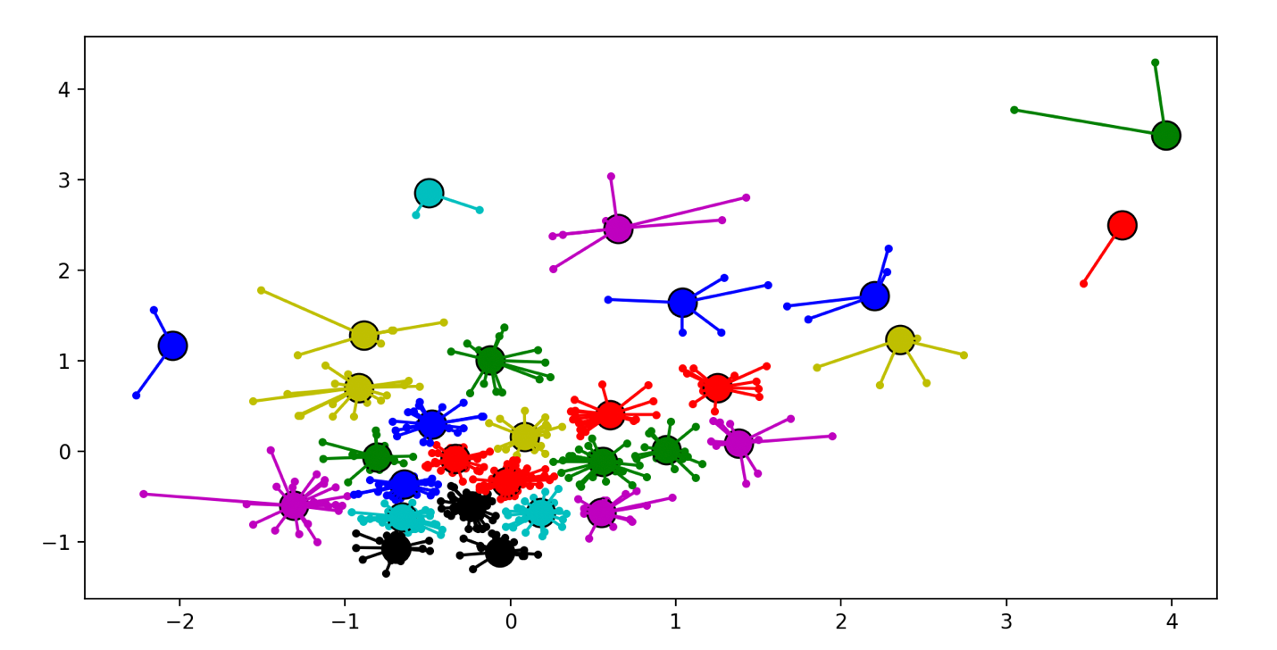
Clustering Output
Affinity propagation groups related stocks before pair evaluation
Each color represents a discovered cluster; cluster membership constrains the candidate pairs for cointegration testing.

Slide 5
Trading Framework
Static hedge baseline and Kalman-filter dynamic hedge
Static Hedging
Fixed hedge ratio estimated from historical relationship.
Simple benchmark for comparing dynamic hedge behavior.
Dynamic Hedging: Kalman Filter
Alpha and beta drift through deterministic process noise.
Alpha noise is kept lower to limit spread distortion.
Beta noise is higher so the hedge ratio adapts faster.
Observation noise is estimated from OLS regression.
Spread z-score lookback window: half-life approach

Slide 6
Signal Rules
Z-score thresholds define entry, exit, and stop-loss events
Stop loss z <= -4
Long spread z <= -2
Exit z = 0
Short spread z >= 2
Stop loss z >= 4
Trades are triggered when the spread deviates materially from equilibrium and closed when it reverts to zero.

Slide 7
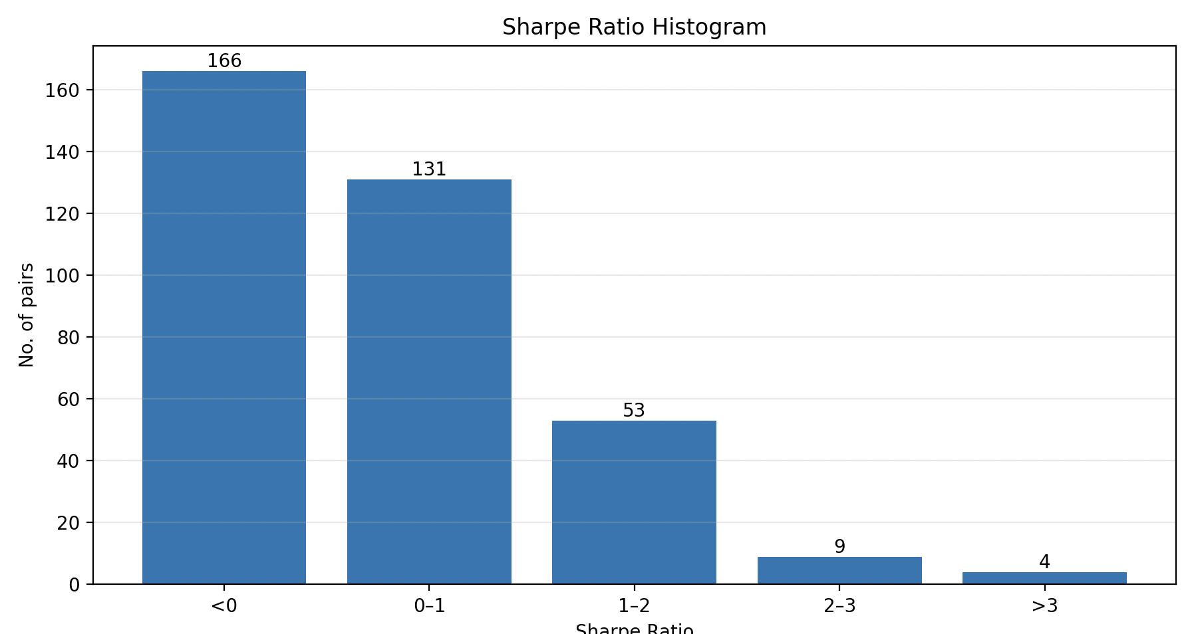
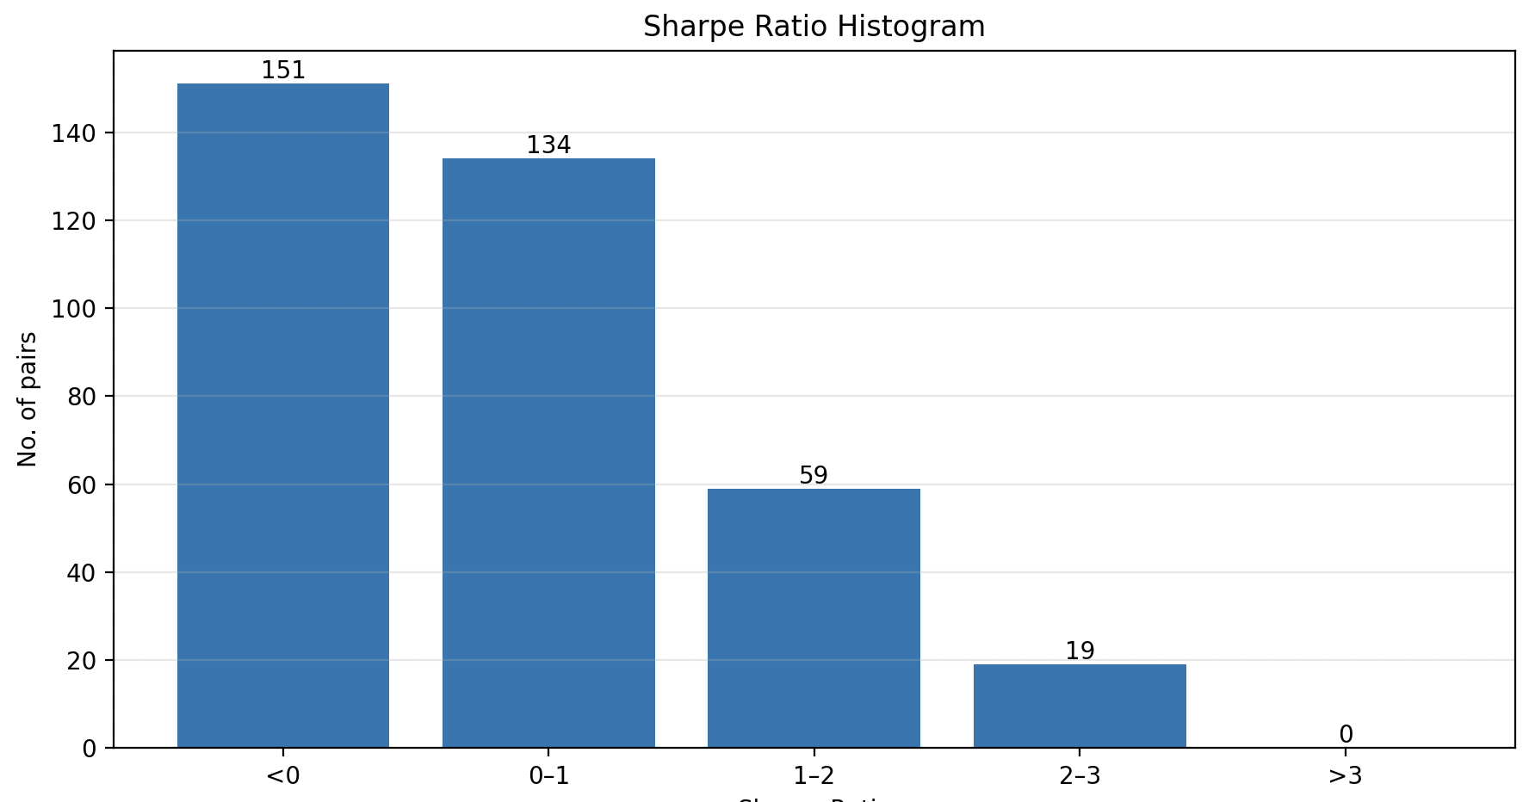
Testing Period Results
Sharpe ratio distributions with and without Kalman filtering
Without Kalman Filter
With Kalman Filter
The Kalman-filter test set has more pairs in the 1-2 and 2-3 Sharpe buckets, but also no pairs above 3 in the displayed histogram.

Slide 8
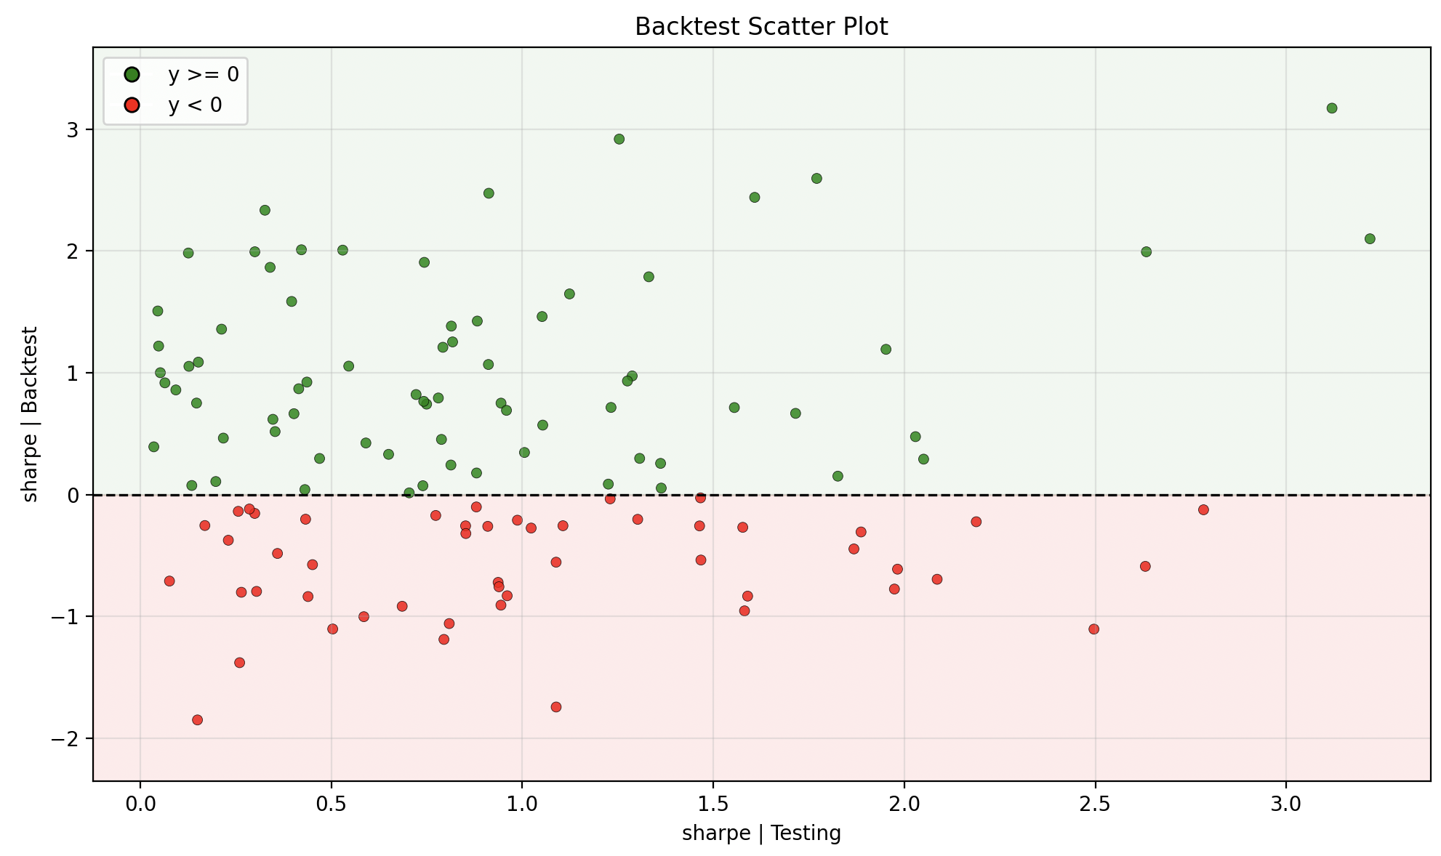
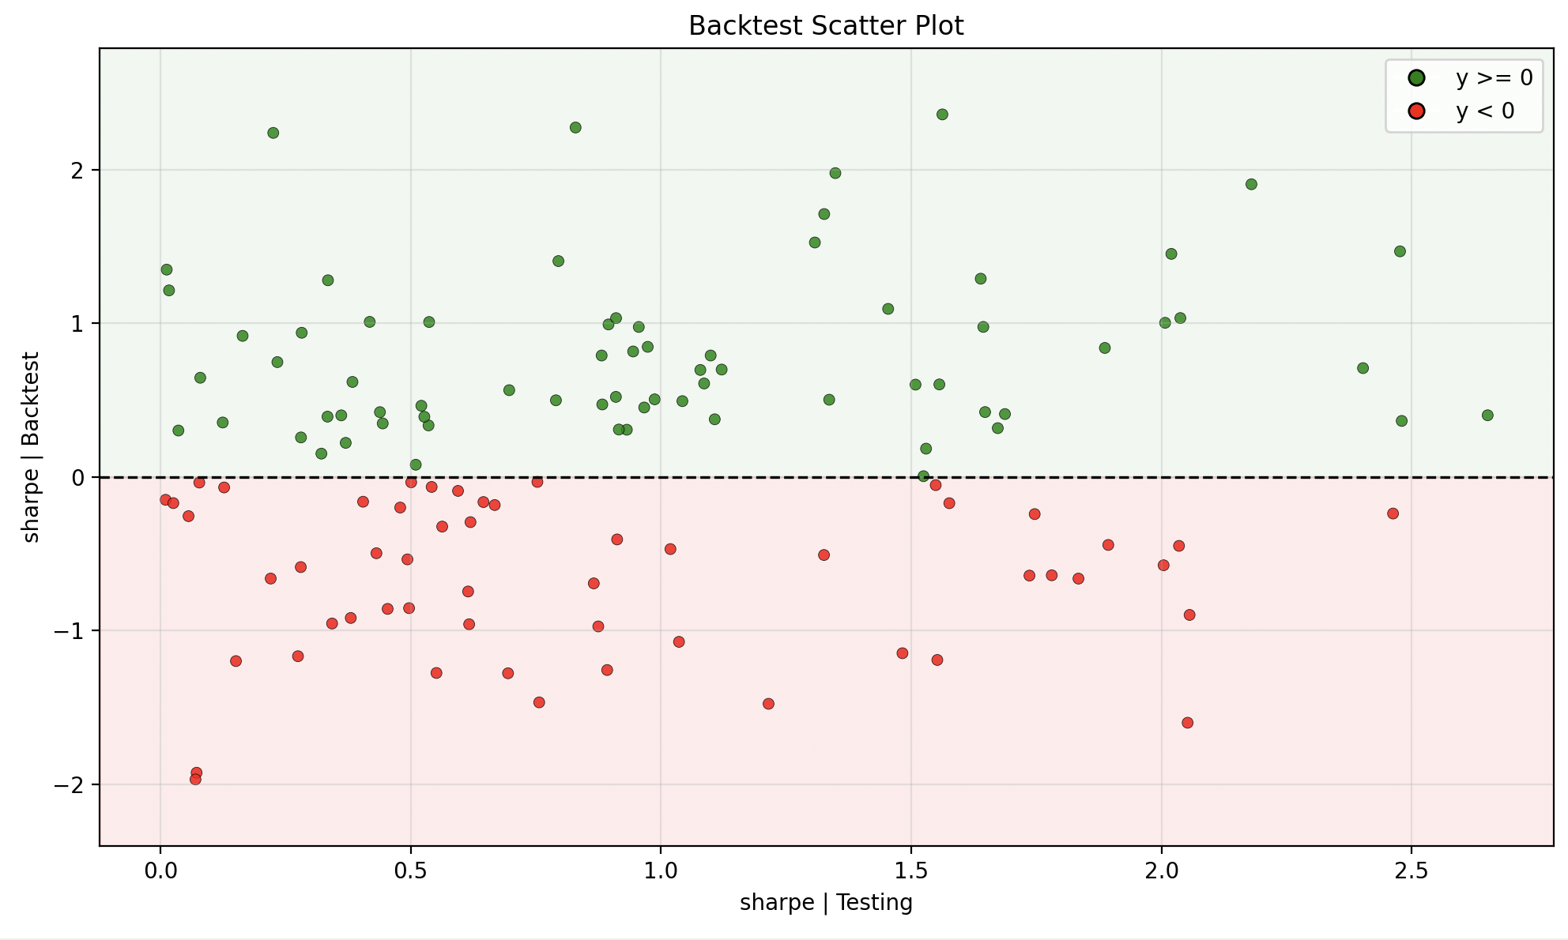
Testing vs. Backtest Comparison
Scatter plots compare testing Sharpe against backtest Sharpe
Without Kalman Filter
With Kalman Filter
Testing Sharpe > 1: 51% of positive-Sharpe pairs
Testing Sharpe > 1: 60% of positive-Sharpe pairs

Slide 9
Proposal Summary
Key design choices and expected evaluation focus
Strategy Design
Universe: S&P 500
Pair discovery: affinity propagation plus 5% cointegration test
Execution rules: z-score entry, zero exit, and +/-4 stop-loss
Evaluation Focus
Compare static hedge against Kalman-filter hedge.
Use testing and backtest Sharpe distributions to assess robustness.
Investigate pairs where testing and backtest Sharpe diverge.
Initial comparison favors the Kalman-filter setup on the percentage of positive-Sharpe pairs with testing Sharpe above 1.

